Slide 1
Tutorial 9
Tree Inference
Ritesh Chidambaram
Blas Rodriguez
Yiru wang

Slide 2
What is MAFFT? (Multiple Alignment using Fast Fourier Transforms)
Program used to create multiple sequence alignments of amino acid or nucleotide sequences.
First version
Published in 2002
Used an algorithm based on progressive alignment
Used Fast Fourier Transforms to cluster the sequences
Current Version
Added other algorithms and modes of operation
Include the following options:
Faster alignment of large numbers
Higher accuracy
Alignment of non-coding RNA sequences
Able to add new sequences to existing alignments

Slide 3
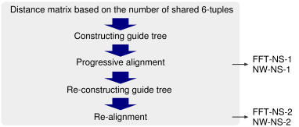
MAFFT Progressive Alignment
Progressive alignment requires two stages:
First stage
Second stage
MAFFT combines these 2 stages with the following tools:
FFT approximation
k-mer counting
Modified UPGMA
Second progressive alignment
Cons
Strongly dependent of a high quality initial alignment.
Notes:
Progressive alignment requires two stages:
First stage
Relationships between the sequences are represented as a tree (guide tree)
Second stage
MSA is built by adding the sequences sequentially according to the guide tree
MAFFT combines these 2 stages with the following tools:
FFT approximation: helps with the clustering of the sequences
k-mer counting: to accelerate the initial calculation of the distance matrix
Modified UPGMA: to construct the guide tree
Second progressive alignment: increase accuracy

Slide 4
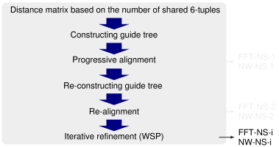
MAFFT Iterative Refinement Method
Similar process to the Progressive method but it adds a repeatedly realign on the initial sequences as well as adding new sequences.
The iterative method also use this tools:
Objective function
Tree-dependent partitioning
Effect of FFT
Cons
Longer processing time than progressive method
Notes:
Similar process to the Progressive method but it adds a repeatedly realign on the initial sequences as well as adding new sequences.
The iterative method also use this tools:
Objective function. Uses the weighted sum-of-pairs (WSP) score proposed by Gotoh to improve precision.
Tree-dependent partitioning. To iterative refine the original tree
Effect of FFT. To test the effect of the FFT approximation

Slide 5
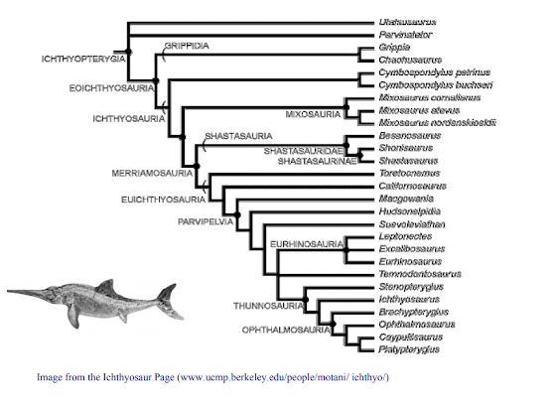
Phylogenetic Inference
Attempt to estimate the evolutionary history of a collection of organisms (taxa) or a family of genes.
Consists of two components -
Estimation of the evolutionary tree.
Using estimated trees (phylogenies) as analytical framework for further evolutionary study.
Phylogenetic tree accurately characterizes the evolutionary lineages among species.

Slide 6
Phylogenetic tree - Structure
Leaves represent things (genes, individuals/strains, species) being compared.
Internal nodes are DNA sequences of the ancestors of the species at the corresponding leaves.
Root of a tree represent the DNA of the common ancestors of all species present in a tree.
In a rooted tree, path from root to a node represents an evolutionary path – the root represents the common ancestor
An unrooted tree specifies relationships among things, but not evolutionary paths

Slide 7
Phylogenetic Tree Approaches
Three general types of methods
Distance: find tree that accounts for estimated evolutionary distances
Parsimony: find the tree that requires minimum number of changes to explain the data
Maximum likelihood: find the tree that maximizes the likelihood of the data ( Method used in RaxML and Fastree)

Slide 8
Maximum Likelihood Method
The process of finding a phylogenetic tree using maximum likelihood involves finding the topology and branch lengths of the tree that will give us the greatest probability of observing the DNA sequences at the leaves of the tree.
Given a data D(DNA sequence of a particular species) and model M. Find tree T such that P(D|T,M) is maximized.
ML algorithm is expensive since it must consider all topologies of trees and find best edge length for each topology.

Slide 9
RaxML
RAxML (randomized axelerated maximum likelihood) is a sequential and parallel program for inference of large phylogenies with maximum likelihood (ML)
RAxML starts by building an initial parsimony tree with dnapars from Felsenstein's PHYLIP package for two reasons:
Parsimony related to maximum likelihood, such that one can expect to obtain a starting tree with a relatively good likelihood value compared to random or neighbor joining starting trees.
dnapars uses stepwise addition for tree building and is relatively fast.
Stepwise addition works by calculating parsimony score for a part of incompletely constructed tree (called “cluster”) at each step instead of the whole tree to get maximum parsimony.

Slide 10
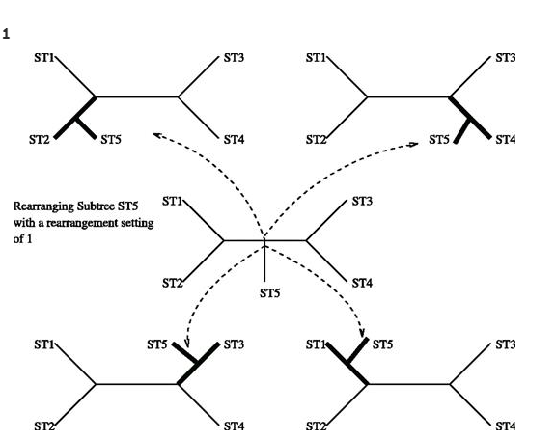
Tree Optimization in RAxML
RAxML performs standard subtree rearrangements by subsequently removing all possible subtrees from the currently best tree t_{best} and re-inserting them into neighboring branches up to a specified distance of nodes. Uses fastDNAml.
It consists of moving all subtrees within the currently best tree up to the maximum distance of nodes specified.

Slide 11
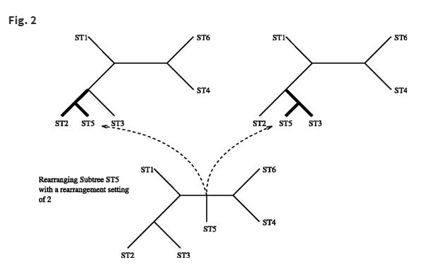
Tree Optimization
fastDNAml after each insertion of a subtree into an alternative branch the branch lengths of the entire tree are optimized to get the best likelihood tree.
RAxML only optimizes the three local branches adjacent to the insertion point analytically before computing its likelihood value.

Slide 12
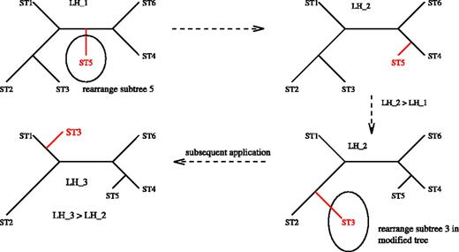
Tree Rearrangement
RAxML uses a list of size 20 to store the best 20 trees obtained during one rearrangement step.
After completion of one rearrangement step the algorithm performs global branch length optimizations on those 20 best topologies only.
Once the best topology is encountered this tree is kept immediately and all subsequent subtree rearrangements of the current step are performed on the improved topology

Slide 13
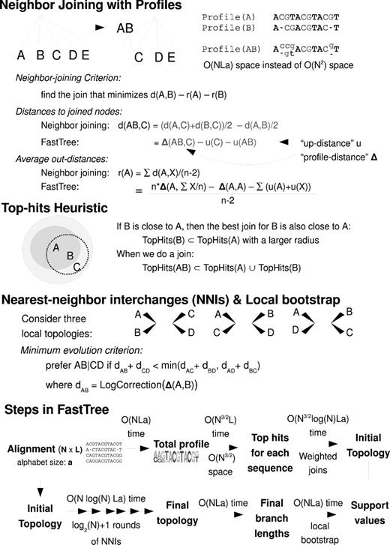
FASTree Algorithm -Creating profiles
FastTree implements Neighbor-Joining by storing profiles for the internal nodes in the tree instead of storing a distance matrix.
Each profile includes a frequency vector for each position, and the profile of an internal node is the weighted average of its children's profiles.
The intuition behind using profiles is that the average of the distances between the sequences in two subtrees A and B equals the distance between profile(A) and profile(B) because profile(A) is the average of the sequences in A
Fasttree uses these profiles to calculate the internal distances between the tree. Storing profiles takes
Notes:
Leaf i = ATGAT
Leaf j= GTCAA
After taking average : at position /index 2=> 50% G and 50% C

Slide 14
FASTtree - Nearest Neighbor Interchanges
FastTree refines the initial topology with nearest neighbor interchanges (NNIs). Given an unrooted tree ((A, B), (C, D)), where A, B, C, and D may be sub-trees rather than individual sequences, FastTree compares the profiles of A, B, C, and D and determines whether alternate topologies ((A, C), (B, D)) or ((A, D), (B, C)) would reduce the length of the tree.
Calculates local bootstrap value for each split ((A,C)),(B,D)) and so on.

Slide 15
RAxML vs FastTree
RAxML produces better ML scores compared to FastTree.
When used with highly accurate alignments, RAxML also tends to produce topologically more accurate trees than FastTree, but the differences tend to be small on large datasets.
When used with less accurate alignments (such as might be estimated on very large datasets) FastTree is competitive with RAxML with respect to tree topology accuracy, and can sometimes be more accurate.
RAxML is computationally much more expensive, taking from 100–1000 times as much time as FastTree.
RAxML produces better ML scores, and more accurate trees than FastTree in many cases, whether RAxML should be used on large datasets must be considered in the light of its increased computational requirements

Slide 16
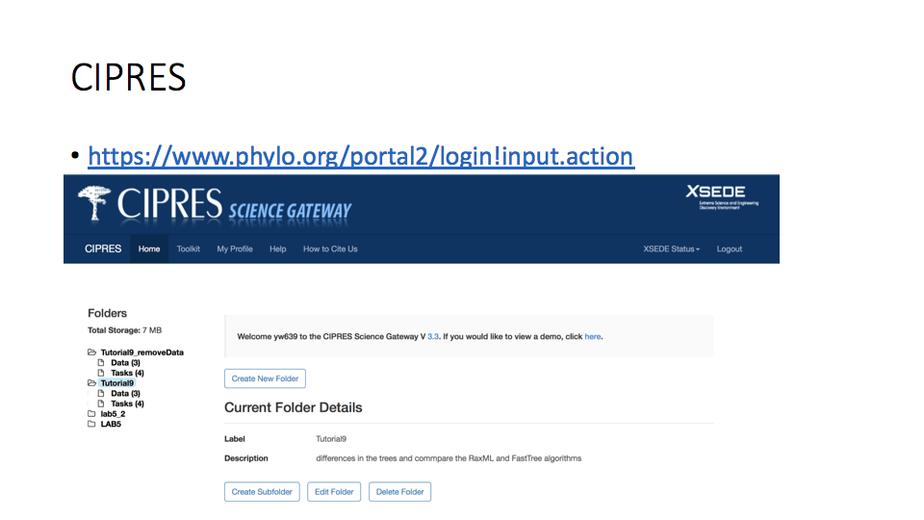
Notes:
We will create a maximum likelihood phylogenetic tree using the Cipres Science Gateway

Slide 17
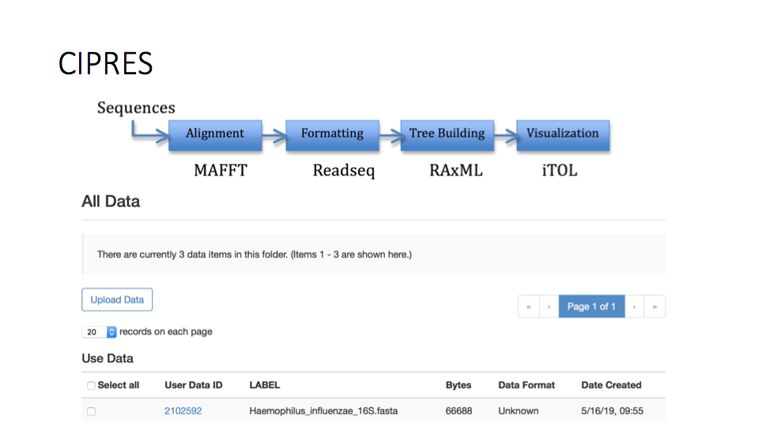
Notes:
Pipeline of creating a ML tree
Before using this website, we need to
Create a Cipres user account
Create a folder for this project
Under the folder, open the data subfolder and upload the data we need to use

Slide 18
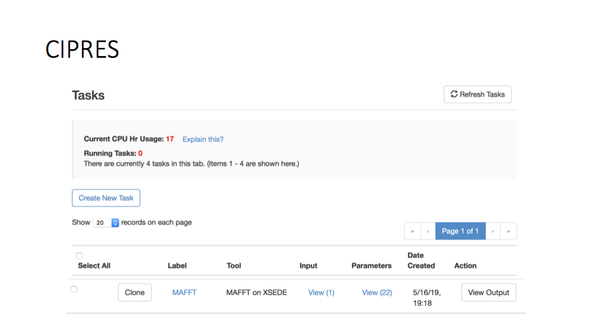
Notes:
Go to the tasks subfolder and create a new task. We need to align our sequences before we construct our tree. Choose the ’MAFFT’ alignment tool. Next, select the data which we uploaded, provide a descriptive name, then save and run the task.
Once the task is complete, click on the View link. Inspect the output.MAFFT ﬁle by View, then click ’Save to current folder’.

Slide 19
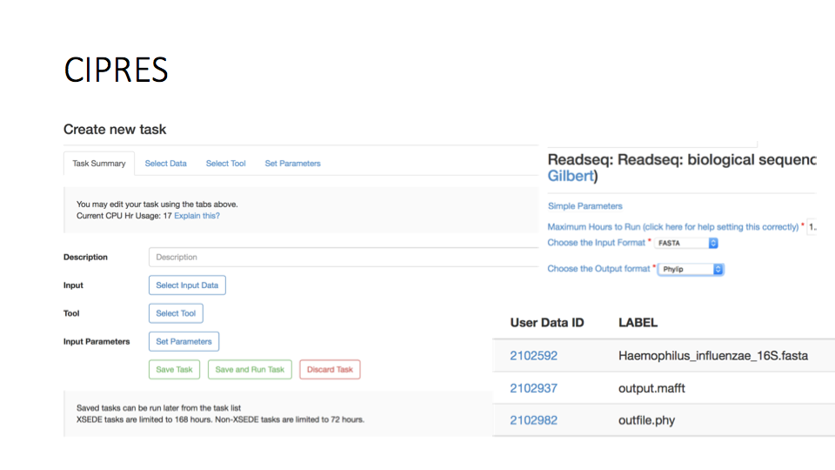
Notes:
We compared the RAxML and Fasttree method. Those algorithms requires the input to be in Phylip format. We can convert the fasta alignment to the Phylip format using the Readseq tool. Create a new task using the Readseq tool. Be sure to select your parameters so that the input format is fasta and the output is Phylip. Save the outﬁle.phy ﬁle to your data folder.

Slide 20
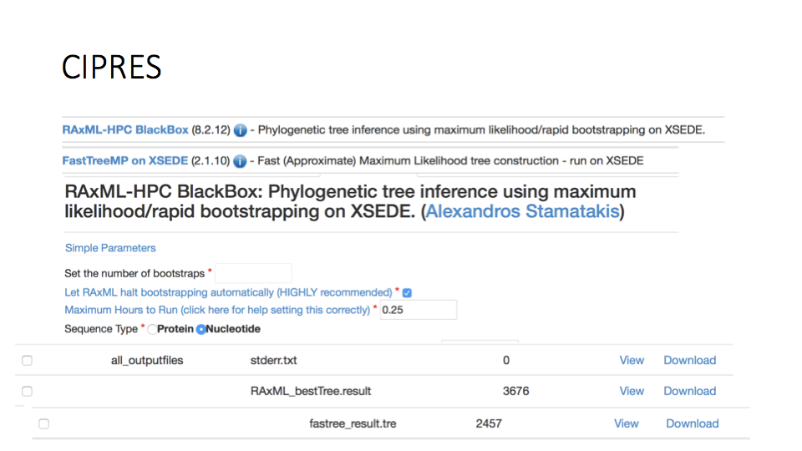
Notes:
Create a new task using the RAxML-HPC Blackbox maximum likelihood algorithm. Be sure the sequence parameter is nucleotide. Use the Phylip ﬁle as the input ﬁle. When the task is complete download the output ﬁle marked RAxML_bestTree.result to the desktop.

Slide 21
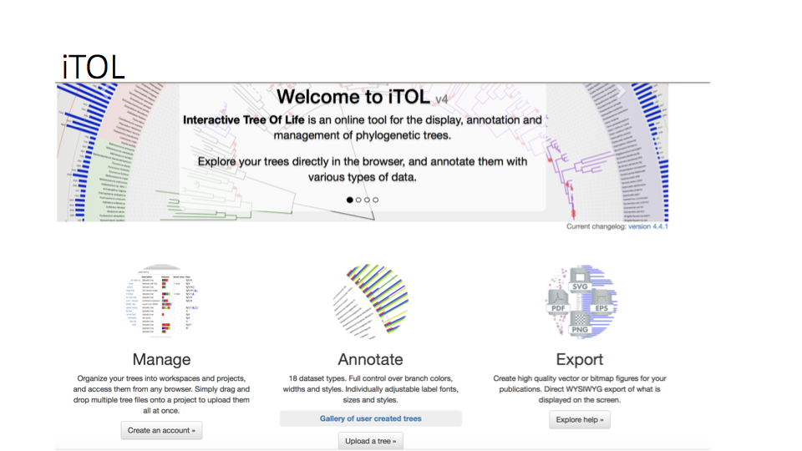
Notes:
We now require a tool to visualize the tree. We will use the iTOL web interface.

Slide 22
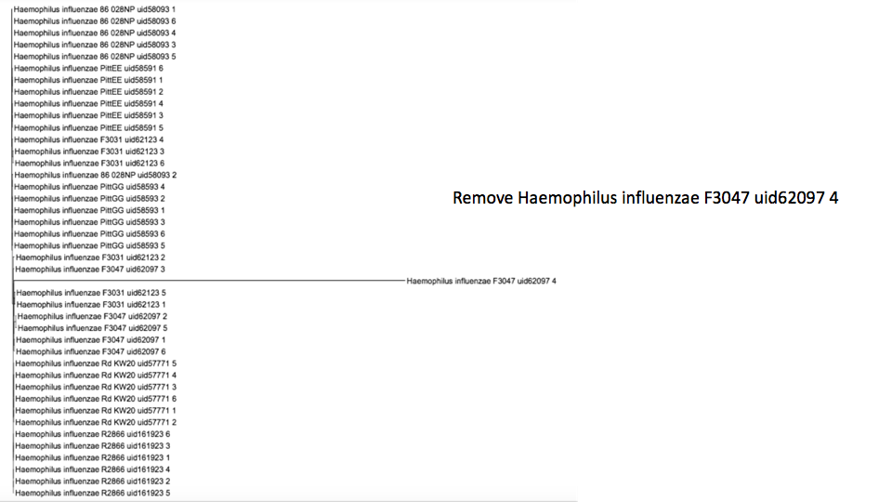

Slide 23
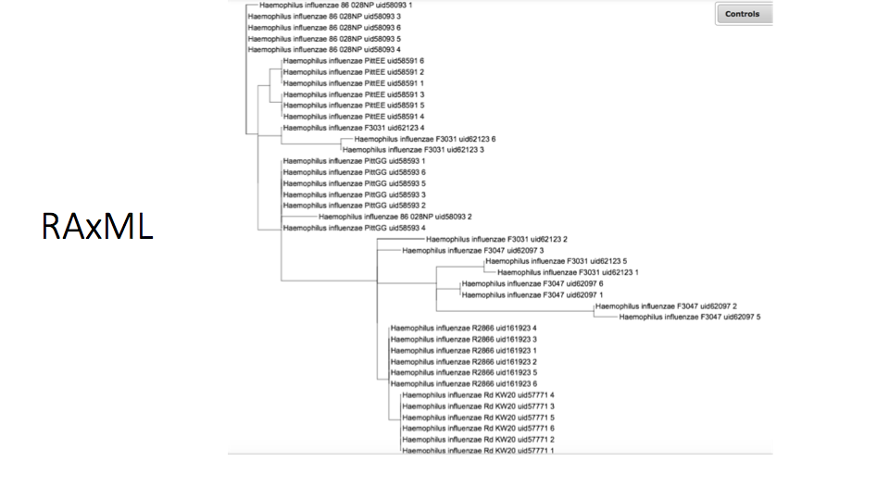

Slide 24
